Slide 1
Random Processes
Gaurav S. Kasbekar
Dept. of Electrical Engineering
IIT Bombay

Slide 2
Motivation
For a study of the noise performance of communication systems (e.g., AM and FM systems), we model noise as a random process:
noise often modeled as Additive White Gaussian Noise
Also, recall that we informally studied power spectral density (PSD) of a random process
Later, we will see that PSD of a wide-sense stationary random process is Fourier transform of its autocorrelation function
So now we study:
random processes,
stationarity, strict-sense stationary and wide-sense stationary processes
mean function and autocorrelation function
power spectral density
Gaussian random processes
white noise processes
models for noise in communication systems

Slide 3
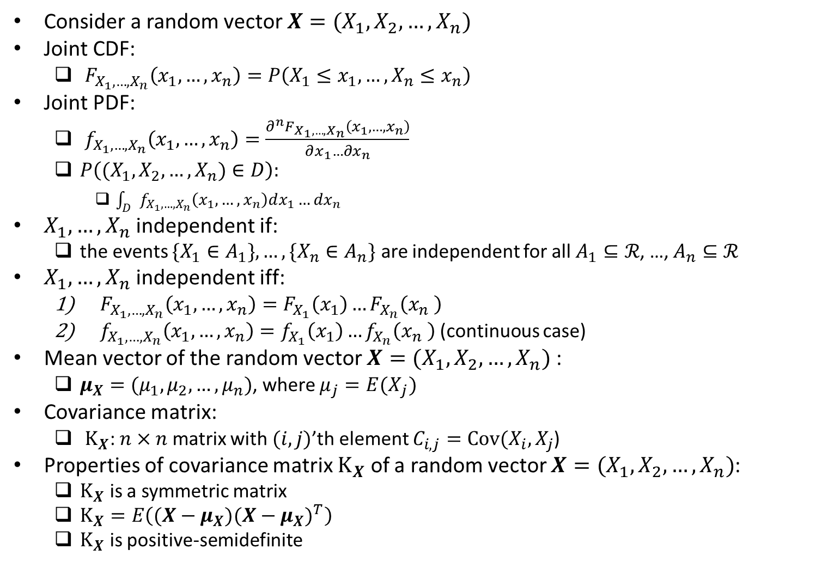
Review of Random Vectors
Consider a random vector $X=(X_{1},X_{2},…,X_{n})$
Joint CDF:
$F_{X_{1}, …,X_{n}}\left(x_{1},…,x_{n}\right)=P\left(X_{1}≤x_{1},…,X_{n}≤x_{n}\right)$
Joint PDF:
$f_{X_{1}, …,X_{n}}\left(x_{1},…,x_{n}\right)=\frac{∂^{n}F_{X_{1}, …,X_{n}}\left(x_{1},…,x_{n}\right)}{∂x_{1}…{∂x}_{n}}$
$P\left((X_{1},X_{2},…,X_{n})∈D\right):$
$\int_{D}{f_{X_{1}, …,X_{n}}\left(x_{1},…,x_{n}\right)dx_{1}…{dx}_{n}}$
$X_{1}, …,X_{n}$ independent if:
the events $\{X_{1}∈A_{1}\}, …,\{X_{n}∈A_{n}\}$ are independent for all$A_{1}⊆ℛ$, …,$A_{n}⊆ℛ$
$X_{1}, …,X_{n}$ independent iff:
$F_{X_{1}, …,X_{n}}\left(x_{1},…,x_{n}\right)=F_{X_{1}}\left(x_{1}\right)…F_{X_{n}}\left(x_{n} \right)$
$f_{X_{1}, …,X_{n}}\left(x_{1},…,x_{n}\right)=f_{X_{1}}\left(x_{1}\right)…f_{X_{n}}\left(x_{n} \right)$ (continuous case)
Mean vector of the random vector $X=(X_{1},X_{2},…,X_{n})$:
$μ_{X}=(μ_{1},μ_{2},…,μ_{n})$, where $μ_{j}={E(X}_{j})$
Covariance matrix:
$K_{X}$: $n×n$ matrix with $(i,j)$’th element $C_{i,j}=Cov(X_{i},X_{j}$)
Properties of covariance matrix $K_{X}$ of a random vector $X=(X_{1},X_{2},…,X_{n})$:
$K_{X}$ is a symmetric matrix
$K_{X}=E\left((X−μ_{X}){(X−μ_{X})}^{T}\right)$
$K_{X}$ is positive-semidefinite

Slide 4
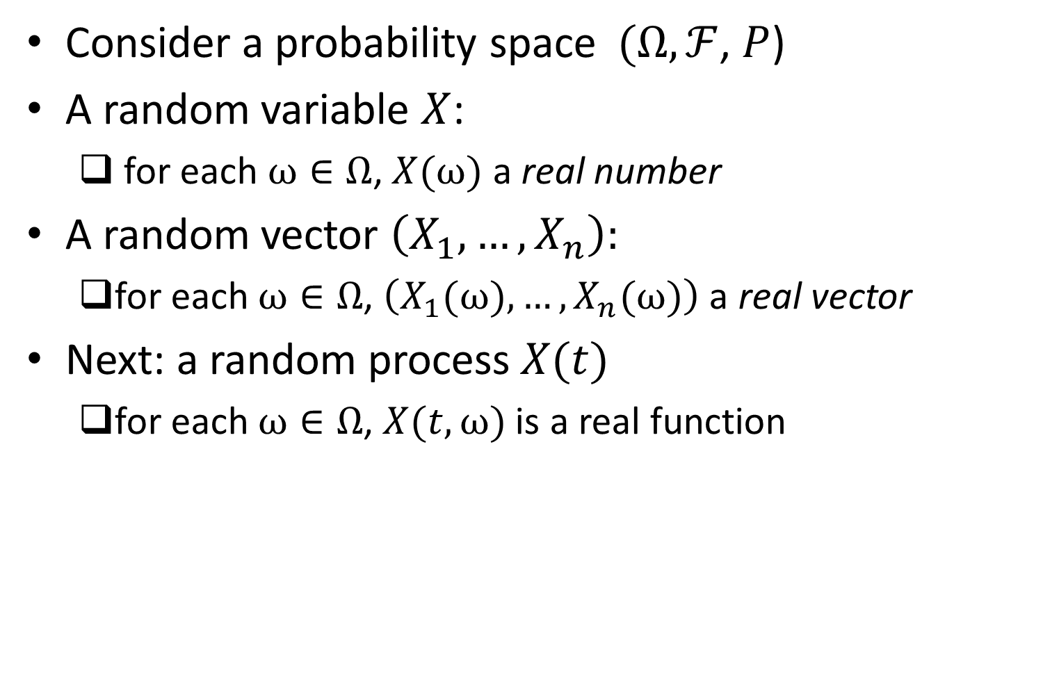
Recall
Consider a probability space $(Ω,ℱ$, $P$)
A random variable $X$:
for each $ω∈Ω$, $X(ω)$ a real number
A random vector $\left(X_{1},…,X_{n}\right):$
for each $ω∈Ω$, $\left(X_{1}(ω),…,X_{n}(ω)\right)$ a real vector
Next: a random process $X(t)$
for each $ω∈Ω$, $X(t,ω)$ is a real function

Slide 5
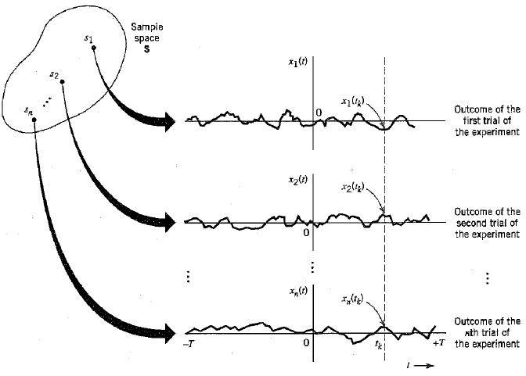
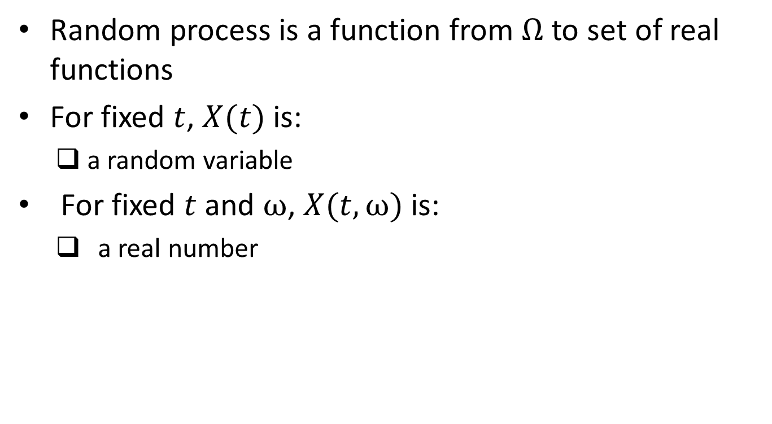
Random Process
Random process is a function from $Ω$ to set of real functions
For fixed $t$, $X(t)$ is:
a random variable
For fixed $t$ and $ω$, $X(t,ω)$ is:
a real number
Ref: Haykin, Chapter 1

Slide 6
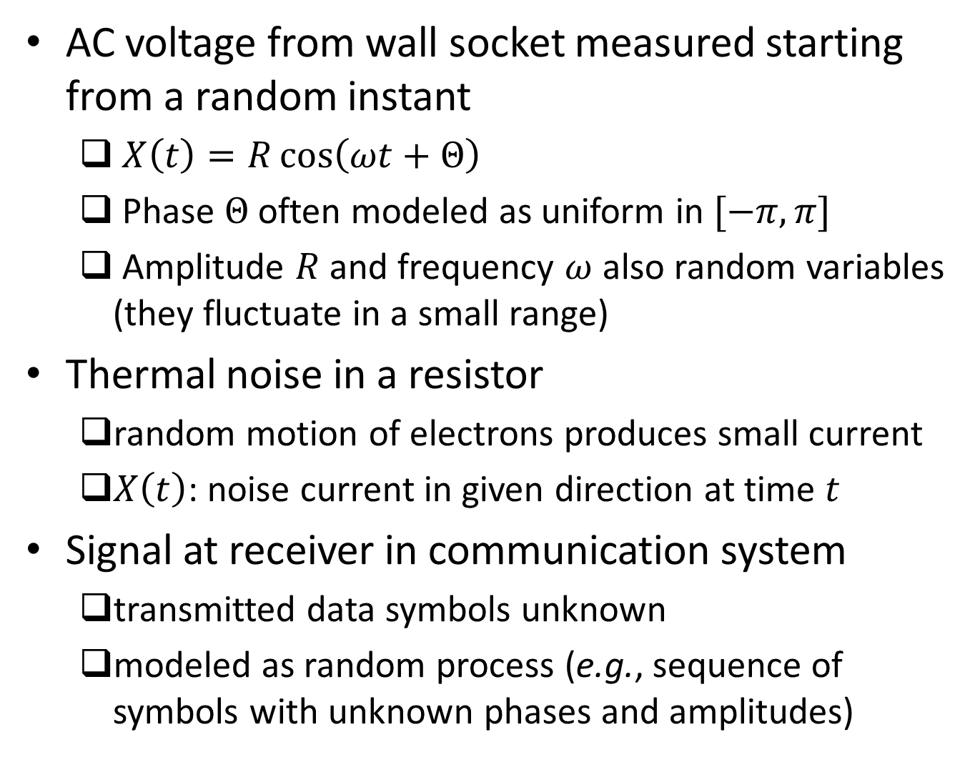
Examples
AC voltage from wall socket measured starting from a random instant
$X\left(t\right)=R\cos\left(ωt+Θ\right)$
Phase $Θ$ often modeled as uniform in $[−π,π]$
Amplitude $R$ and frequency $ω$ also random variables (they fluctuate in a small range)
Thermal noise in a resistor
random motion of electrons produces small current
$X\left(t\right)$: noise current in given direction at time $t$
Signal at receiver in communication system
transmitted data symbols unknown
modeled as random process (e.g., sequence of symbols with unknown phases and amplitudes)

Slide 7
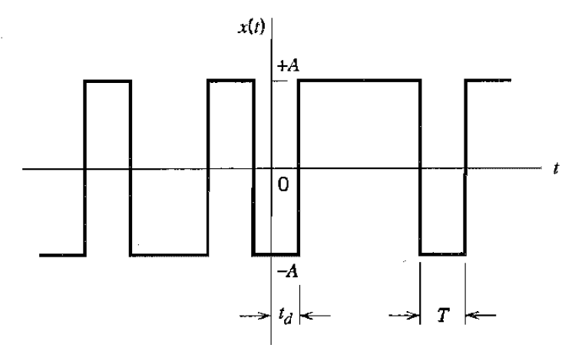

Examples (contd.)
E.g. of signal at receiver in communication system
Each pulse of width $T$, amplitude $A$ or $−A$ with probability $½$ each, independently of other pulses
$t_{d}$: uniform in $[0,T]$
Ref: Haykin, Chapter 1

Slide 8
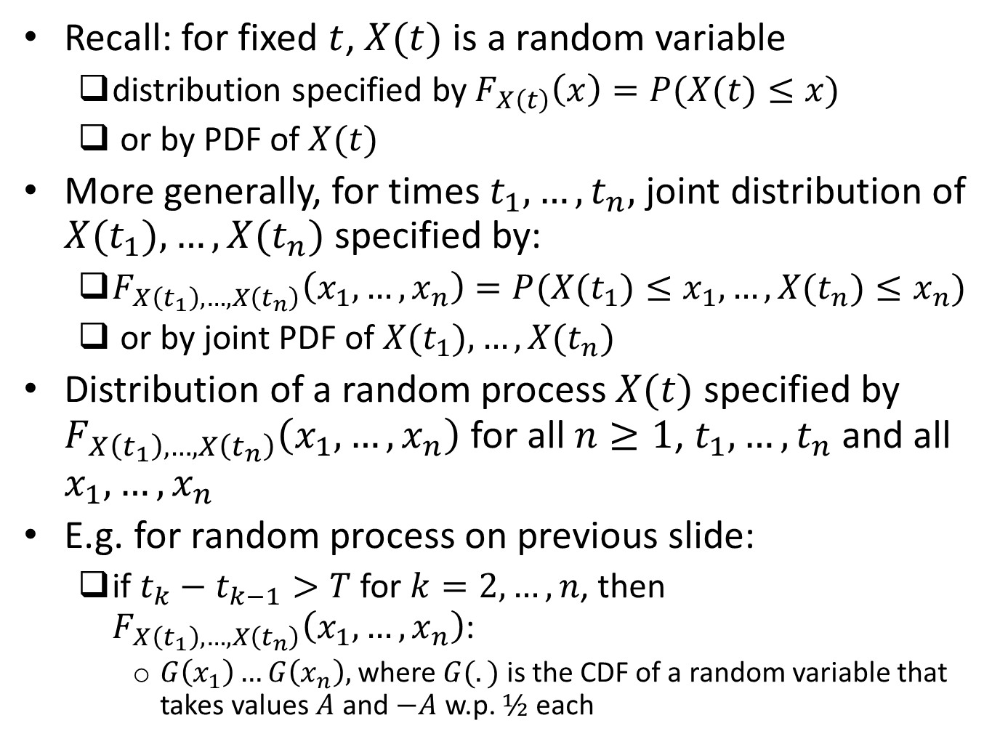
Distribution
Recall: for fixed $t$, $X(t)$ is a random variable
distribution specified by $F_{X\left(t\right)}\left(x\right)=P(X(t)≤x)$
or by PDF of $X(t)$
More generally, for times $t_{1}, …,t_{n},$ joint distribution of ${X(t}_{1}),…,{X(t}_{n})$ specified by:
$F_{X\left(t_{1}\right),…,X\left(t_{n}\right)}\left(x_{1},…,x_{n}\right)=P(X(t_{1})≤x_{1},…,X(t_{n})≤x_{n})$
or by joint PDF of ${X(t}_{1}),…,{X(t}_{n})$
Distribution of a random process $X(t)$ specified by $F_{X\left(t_{1}\right),…,X\left(t_{n}\right)}\left(x_{1},…,x_{n}\right)$ for all $n≥1$, $t_{1}, …,t_{n}$ and all $x_{1},…,x_{n}$
E.g. for random process on previous slide:
if $t_{k}−t_{k−1}>T$ for $k=2,…,n$, then $F_{X\left(t_{1}\right),…,X\left(t_{n}\right)}\left(x_{1},…,x_{n}\right)$:
$G\left(x_{1}\right)…G\left(x_{n}\right),$ where $G(.)$ is the CDF of a random variable that takes values $A$ and $−A$ w.p. $½$ each

Slide 9
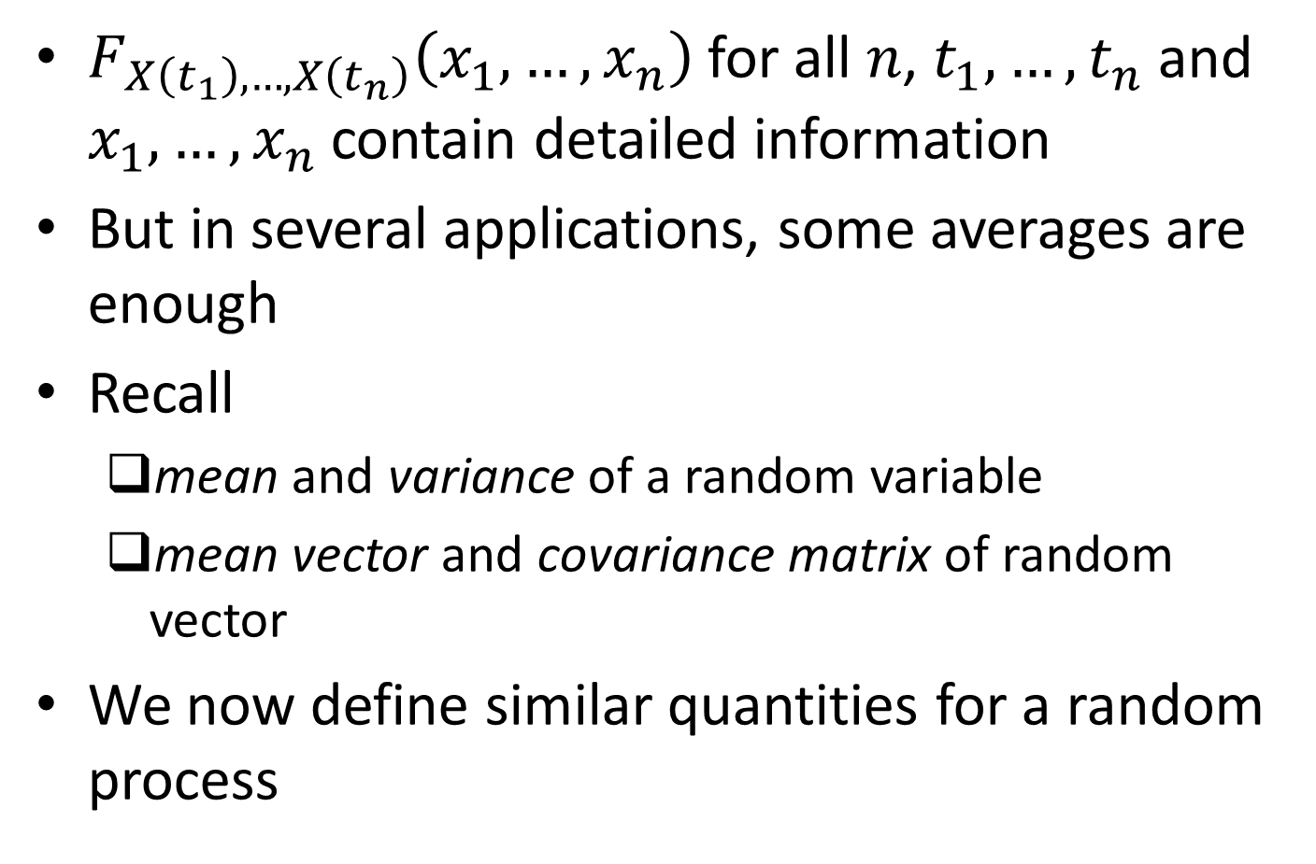
Averages
$F_{X\left(t_{1}\right),…,X\left(t_{n}\right)}\left(x_{1},…,x_{n}\right)$ for all $n$, $t_{1}, …,t_{n}$ and $x_{1},…,x_{n}$ contain detailed information
But in several applications, some averages are enough
Recall
mean and variance of a random variable
mean vector and covariance matrix of random vector
We now define similar quantities for a random process

Slide 10
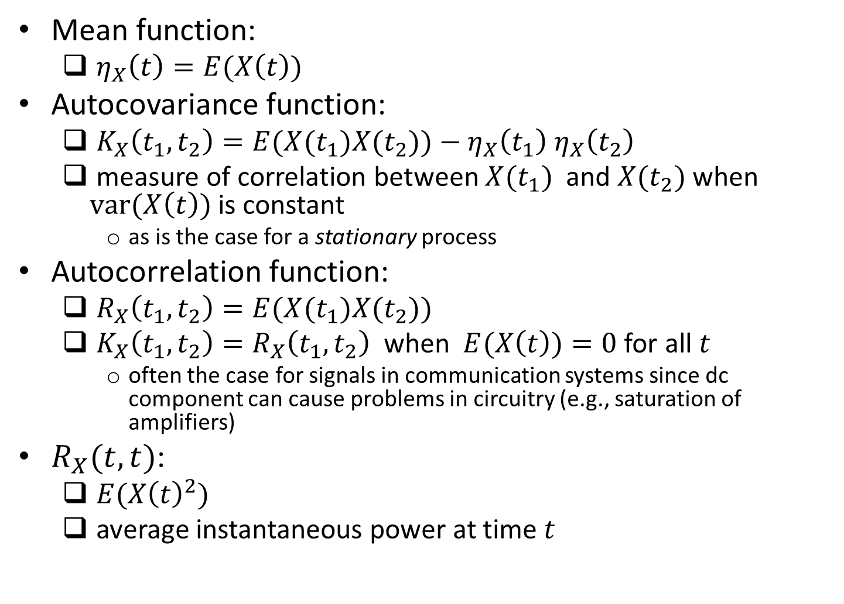
Mean, Autocovariance and Autocorrelation Functions
Mean function:
$η_{X}\left(t\right)=E(X\left(t\right))$
Autocovariance function:
$K_{X}\left(t_{1},t_{2}\right)=E({X(t}_{1}){X(t}_{2}))−η_{X}\left(t_{1}\right)$ $η_{X}\left(t_{2}\right)$
measure of correlation between ${X(t}_{1})$and ${X(t}_{2})$ when $\text{var}\text{(}X\left(t\right))$ is constant
as is the case for a stationary process
Autocorrelation function:
$R_{X}\left(t_{1},t_{2}\right)=E({X(t}_{1}){X(t}_{2}))$
${K_{X}\left(t_{1},t_{2}\right)=R}_{X}\left(t_{1},t_{2}\right)$ when $E(X\left(t\right))=0$ for all $t$
often the case for signals in communication systems since dc component can cause problems in circuitry (e.g., saturation of amplifiers)
$R_{X}(t,t)$:
$E({X\left(t\right)}^{2})$
average instantaneous power at time $t$

Slide 11
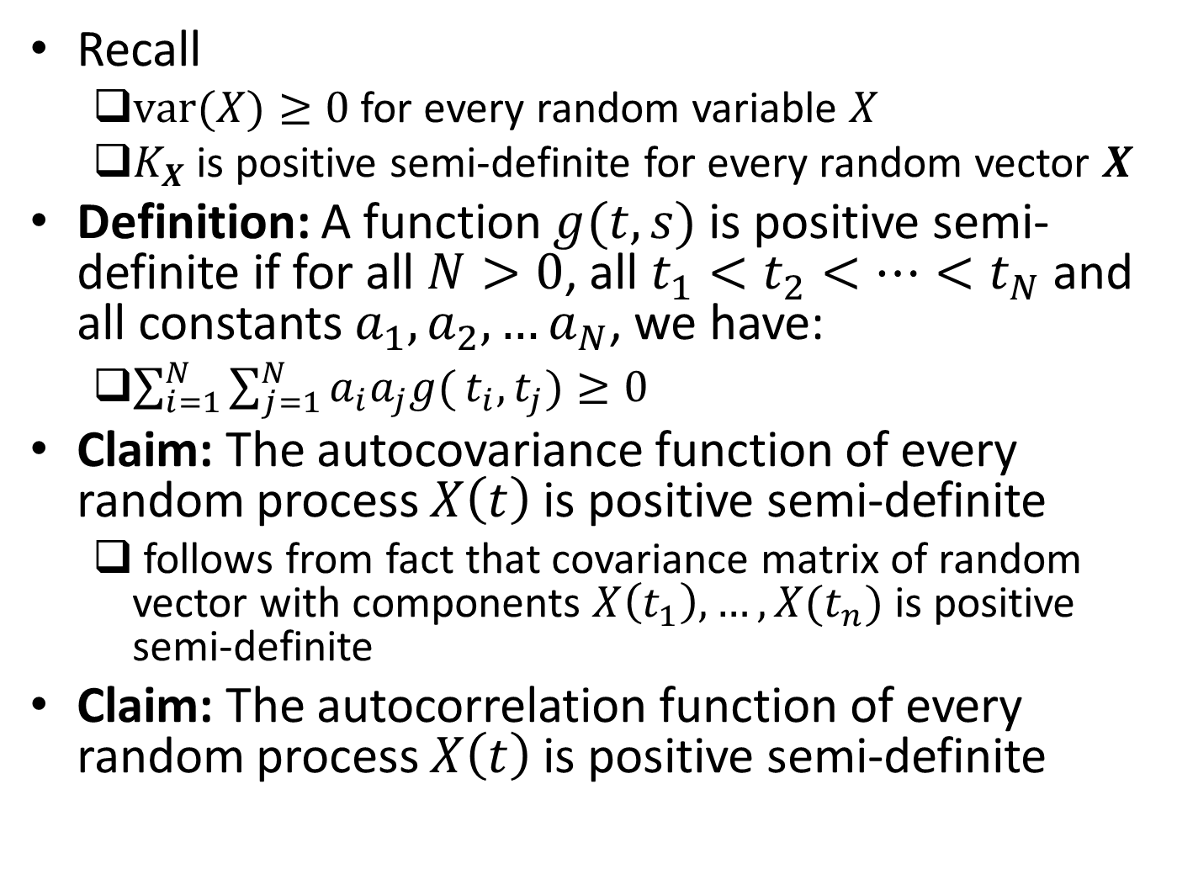
Positive Semi-definiteness
Recall
$var(X)≥0$ for every random variable $X$
$K_{X}$ is positive semi-definite for every random vector $X$
Definition: A function $g(t,s)$ is positive semi-definite if for all $N>0$, all $t_{1}<t_{2}<…<t_{N}$ and all constants $a_{1},a_{2},…a_{N}$, we have:
$\sum_{i=1}^{N}{\sum_{j=1}^{N}{a_{i}a_{j}g(}}t_{i},t_{j})≥0$
Claim: The autocovariance function of every random process $X\left(t\right)$ is positive semi-definite
follows from fact that covariance matrix of random vector with components $X\left(t_{1}\right),…,X(t_{n})$ is positive semi-definite
Claim: The autocorrelation function of every random process $X\left(t\right)$ is positive semi-definite

Slide 12
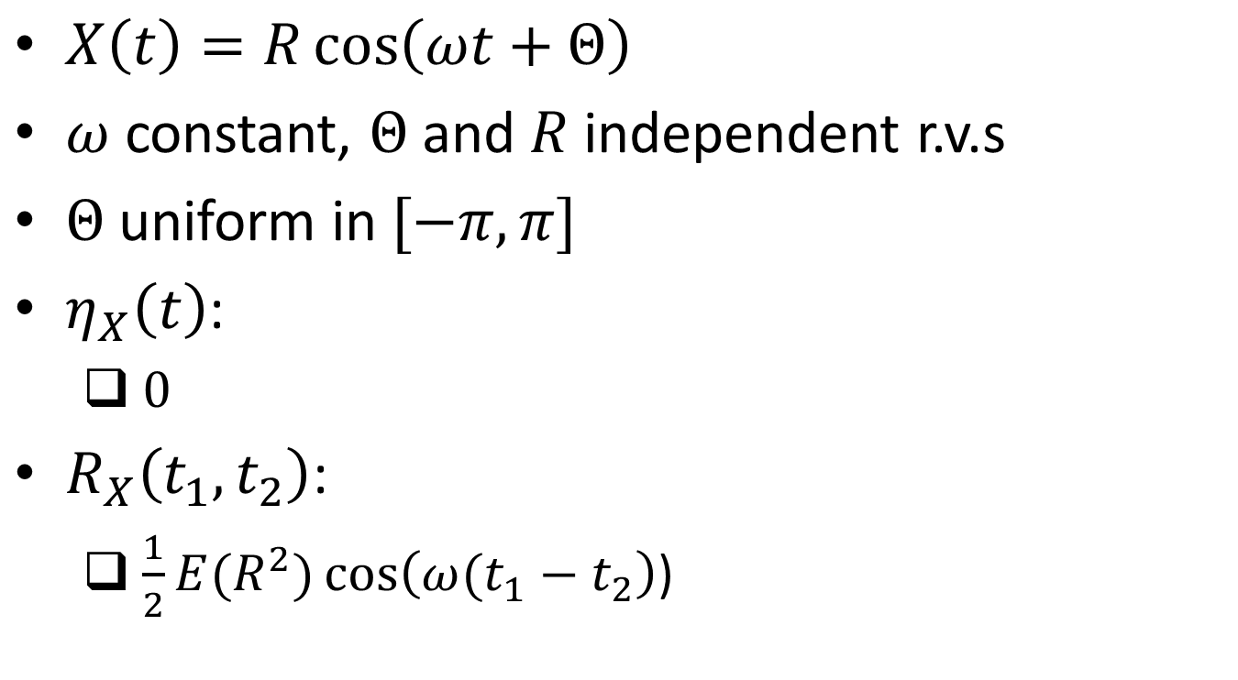
Example
$X\left(t\right)=R\cos\left(ωt+Θ\right)$
$ω$ constant, $Θ$ and $R$ independent r.v.s
$Θ$ uniform in $[−π,π]$
$η_{X}\left(t\right)$:
$0$
$R_{X}\left(t_{1},t_{2}\right)$:
$\frac{1}{2}E(R^{2})\cos\left(ω(t_{1}−t_{2}\right)$)

Slide 13
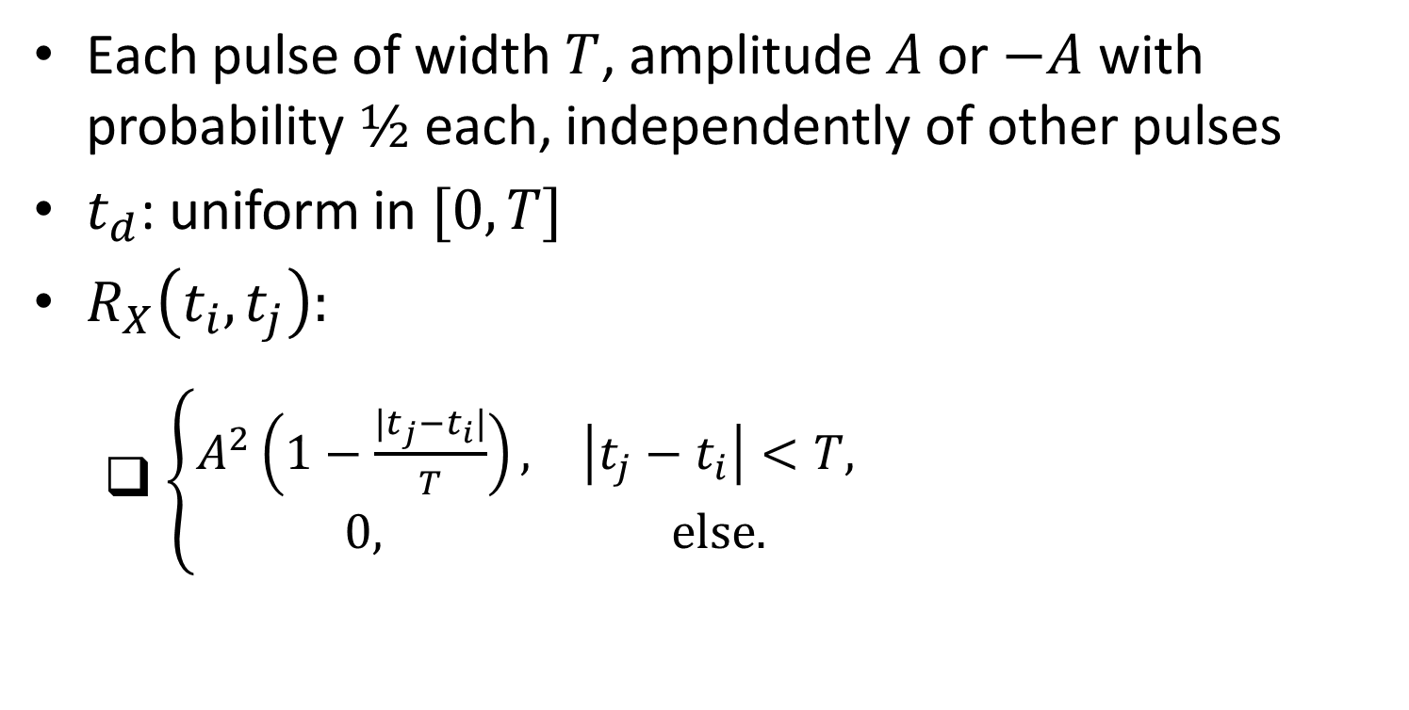
Example
Each pulse of width $T$, amplitude $A$ or $−A$ with probability $½$ each, independently of other pulses
$t_{d}$: uniform in $[0,T]$
$R_{X}\left(t_{i},t_{j}\right):$
$\left\{\begin{matrix}A^{2}\left(1−\frac{|t_{j}−t_{i}|}{T}\right), & \left|t_{j}−t_{i}\right|<T, \\ 0, & \text{else}.\end{matrix}\right.$
Ref: Haykin, Chapter 1

Slide 14
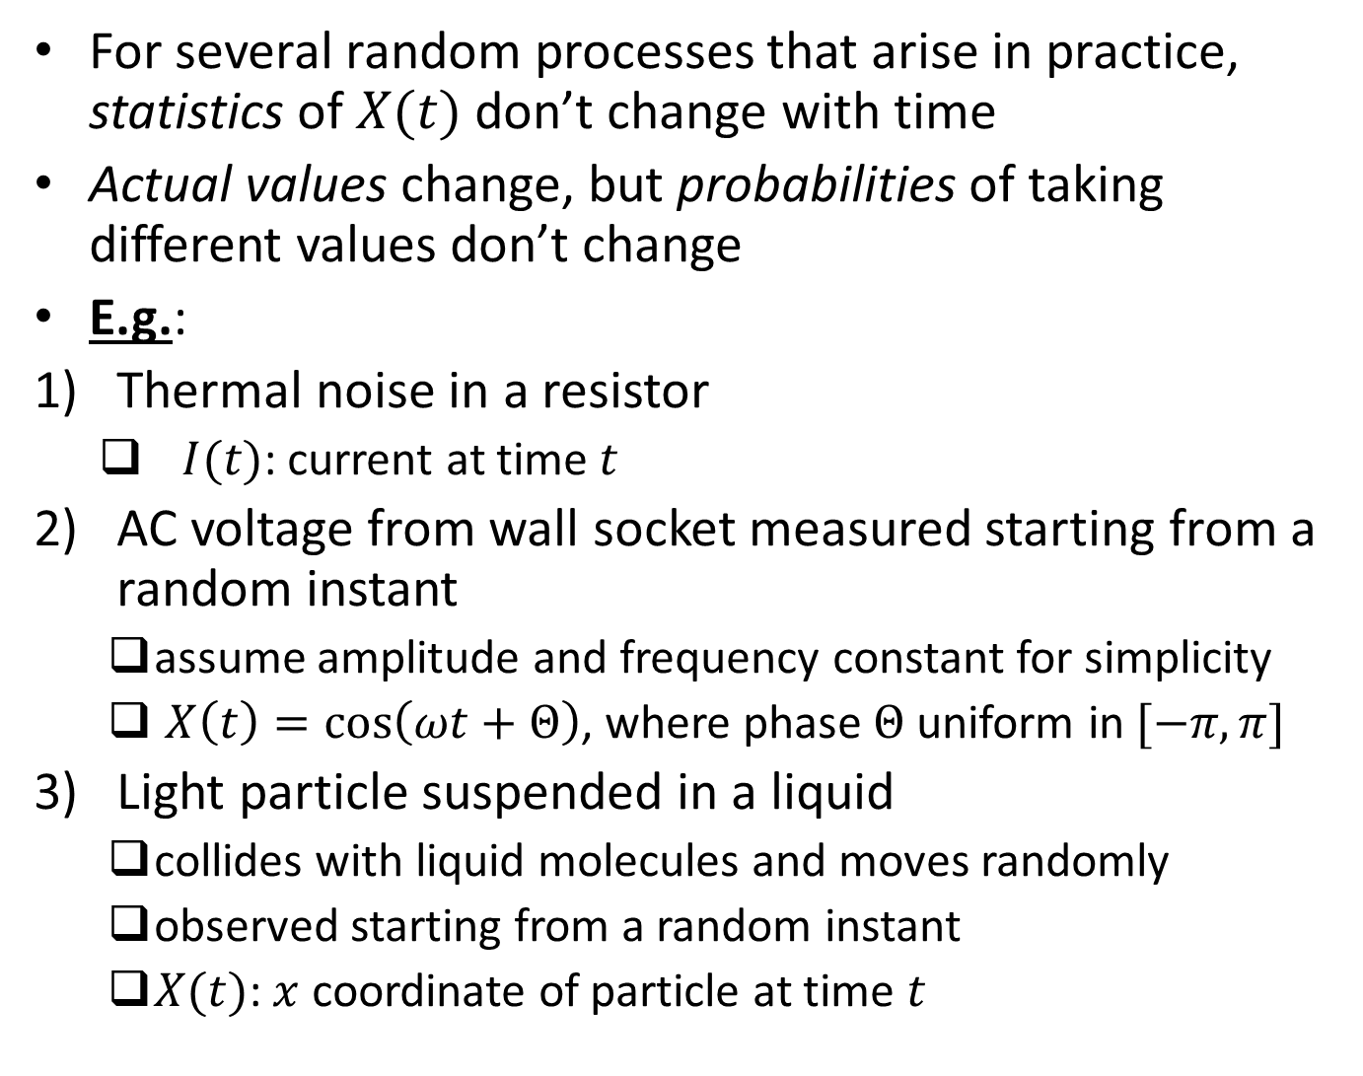
Stationary Processes
For several random processes that arise in practice, statistics of $X(t)$ don’t change with time
Actual values change, but probabilities of taking different values don’t change
E.g.:
Thermal noise in a resistor
$I(t)$: current at time $t$
AC voltage from wall socket measured starting from a random instant
assume amplitude and frequency constant for simplicity
$X\left(t\right)=\cos\left(ωt+Θ\right)$, where phase $Θ$ uniform in $[−π,π]$
Light particle suspended in a liquid
collides with liquid molecules and moves randomly
observed starting from a random instant
$X(t)$: $x$ coordinate of particle at time $t$

Slide 15
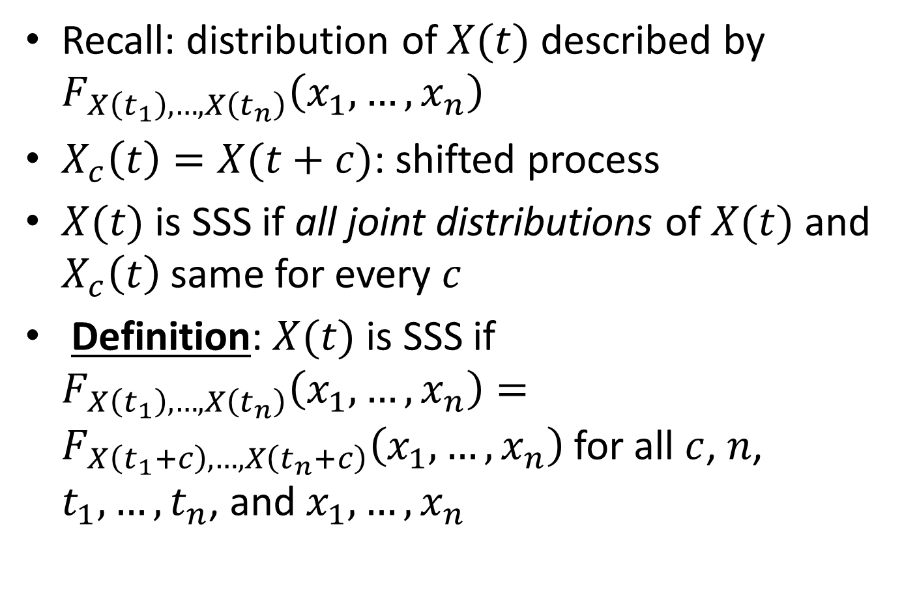
Strict Sense Stationarity
Recall: distribution of $X(t)$ described by $F_{X\left(t_{1}\right),…,X\left(t_{n}\right)}\left(x_{1},…,x_{n}\right)$
$X_{c}\left(t\right)=X(t+c)$: shifted process
$X(t)$ is SSS if all joint distributions of $X(t)$ and $X_{c}\left(t\right)$ same for every $c$
Definition: $X(t)$ is SSS if $F_{X\left(t_{1}\right),…,X\left(t_{n}\right)}\left(x_{1},…,x_{n}\right)=F_{X\left(t_{1}+c\right),…,X\left(t_{n}+c\right)}\left(x_{1},…,x_{n}\right)$ for all $c$, $n$, $t_{1},…,t_{n}$, and $x_{1},…,x_{n}$

Slide 16
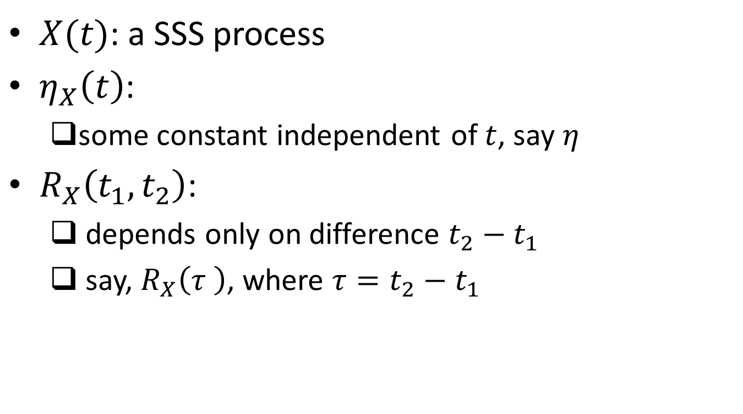
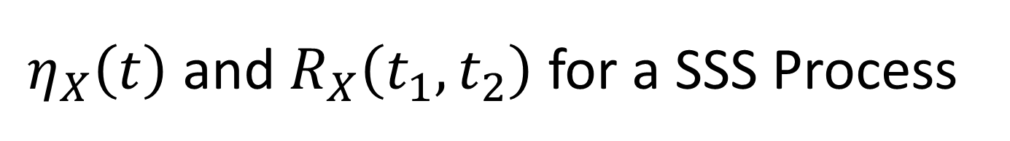
$η_{X}\left(t\right)$ and $R_{X}\left(t_{1},t_{2}\right)$ for a SSS Process
$X(t)$: a SSS process
$η_{X}\left(t\right)$:
some constant independent of $t$, say $η$
$R_{X}\left(t_{1},t_{2}\right)$:
depends only on difference $t_{2}−t_{1}$
say, $R_{X}\left(τ \right)$, where $τ=t_{2}−t_{1}$

Slide 17
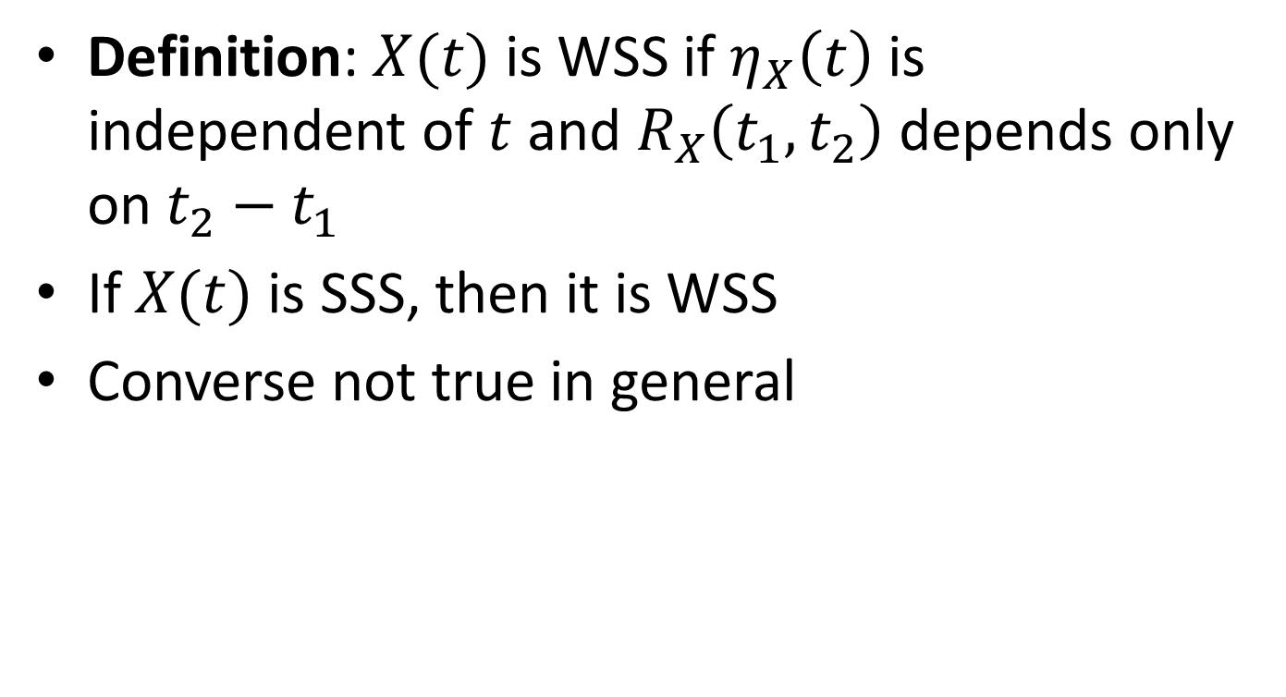
Wide Sense Stationarity
Definition: $X(t)$ is WSS if $η_{X}\left(t\right)$ is independent of $t$ and $R_{X}\left(t_{1},t_{2}\right)$ depends only on $t_{2}−t_{1}$
If $X(t)$ is SSS, then it is WSS
Converse not true in general

Slide 18
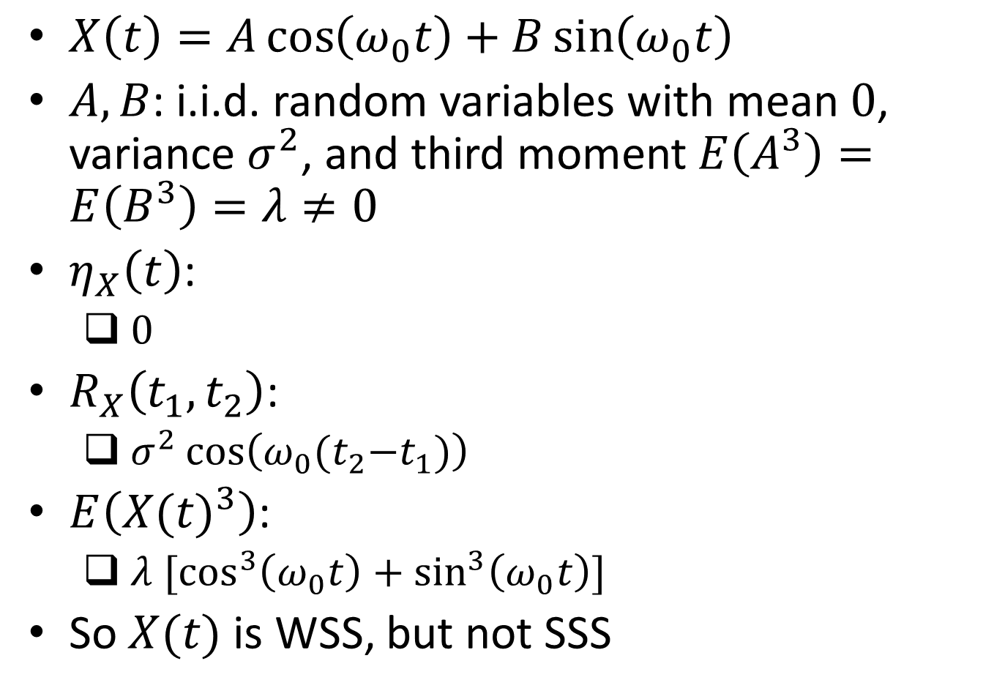
Example
$X\left(t\right)=A\cos\left(ω_{0}t\right)+B\sin\left(ω_{0}t\right)$
$A,B$: i.i.d. random variables with mean $0$, variance $σ^{2}$, and third moment $E\left(A^{3}\right)=E\left(B^{3}\right)=λ≠0$
$η_{X}\left(t\right)$:
$0$
$R_{X}\left(t_{1},t_{2}\right)$:
$σ^{2}\cos\left(ω_{0}{(t}_{2}−t_{1})\right)$
$E\left({X(t)}^{3}\right)$:
$λ {\text{[}\text{cos}}^{3}\left(ω_{0}t\right)+\sin^{3}\left(ω_{0}t\right)]$
So $X(t)$ is WSS, but not SSS

Slide 19
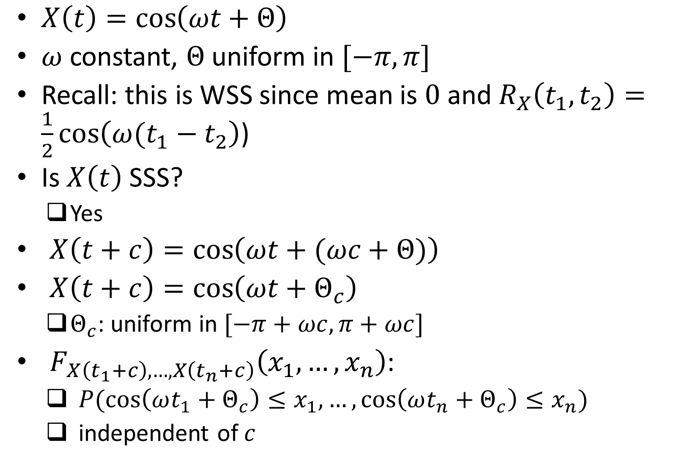
Example
$X\left(t\right)=\cos\left(ωt+Θ\right)$
$ω$ constant, $Θ$ uniform in $[−π,π]$
Recall: this is WSS since mean is $0$ and $R_{X}\left(t_{1},t_{2}\right)=\frac{1}{2}\cos\left(ω(t_{1}−t_{2}\right)$)
Is $X\left(t\right)$ SSS?
Yes
$X\left(t+c\right)=\cos\left(ωt+(ωc+Θ)\right)$
$X\left(t+c\right)=\cos\left(ωt+Θ_{c}\right)$
$Θ_{c}$: uniform in $[−π+ωc,π+ωc]$
$F_{X\left(t_{1}+c\right),…,X\left(t_{n}+c\right)}\left(x_{1},…,x_{n}\right)$:
$P(\cos\left(ωt_{1}+Θ_{c}\right)≤x_{1},…,\cos\left(ωt_{n}+Θ_{c}\right)≤x_{n})$
independent of $c$

Slide 20
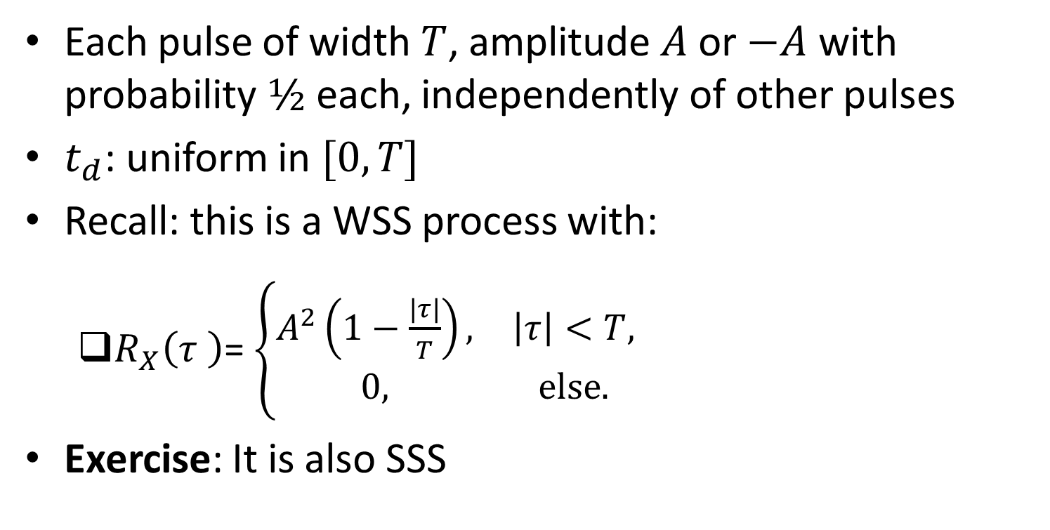
Example
Each pulse of width $T$, amplitude $A$ or $−A$ with probability $½$ each, independently of other pulses
$t_{d}$: uniform in $[0,T]$
Recall: this is a WSS process with:
$R_{X}\left(τ \right)$= $\left\{\begin{matrix}A^{2}\left(1−\frac{|τ|}{T}\right), & \left|τ\right|<T, \\ 0, & \text{else}.\end{matrix}\right.$
Exercise: It is also SSS
Ref: Haykin, Chapter 1

Slide 21


Properties of $R_{X}\left(τ \right)$
$R_{X}\left(0\right)$:
$E({X\left(t\right)}^{2})$
average power
$R_{X}\left(τ \right)=R_{X}\left(−τ \right)$ $∀ τ$
${|R}_{X}\left(τ \right)|≤R_{X}\left(0 \right)$ $∀ τ$

Slide 22
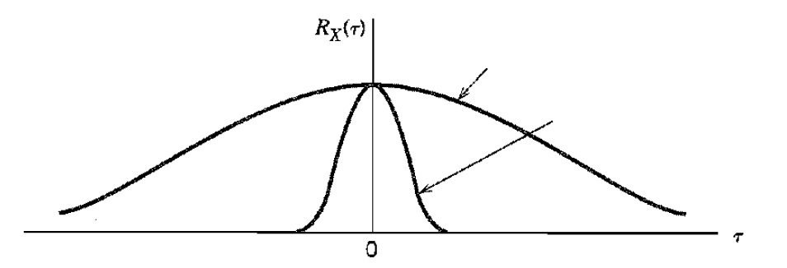


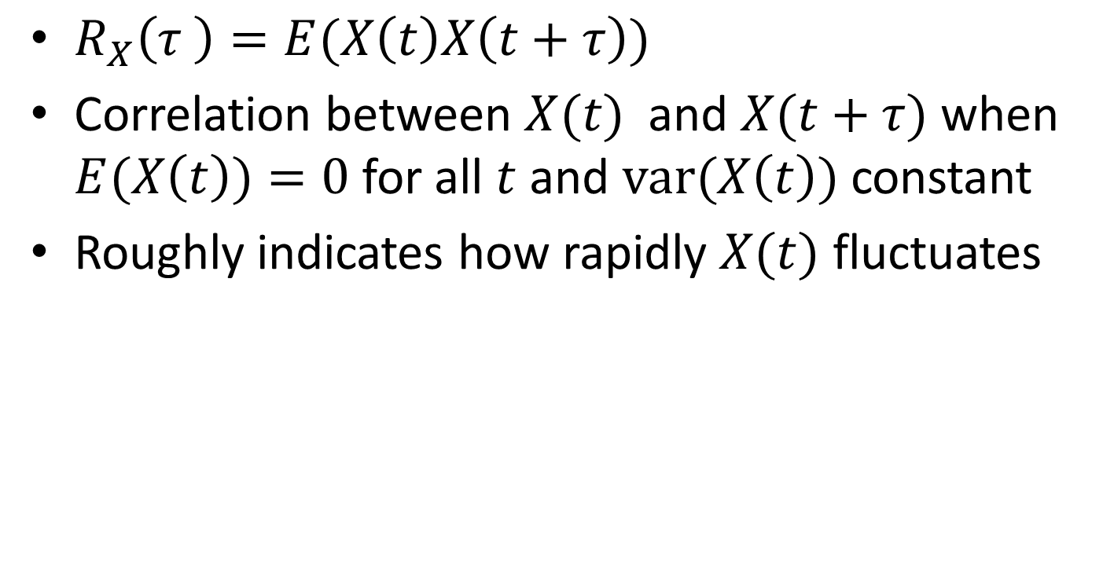
Speed of Fluctuation of Process
$R_{X}\left(τ \right)=E(X\left(t\right)X\left(t+τ\right))$
Correlation between $X(t)$and $X(t+τ)$when $E(X\left(t\right))=0$ for all $t$ and $\text{var}\text{(}X\left(t\right))$ constant
Roughly indicates how rapidly $X(t)$ fluctuates
Ref: Haykin, Chapter 1

Slide 23

Power Spectral Density
Informally, density of average power, $E\left({X\left(t\right)}^{2}\right),$ at frequency $f$
Similar to energy spectral density for deterministic signals

Slide 24
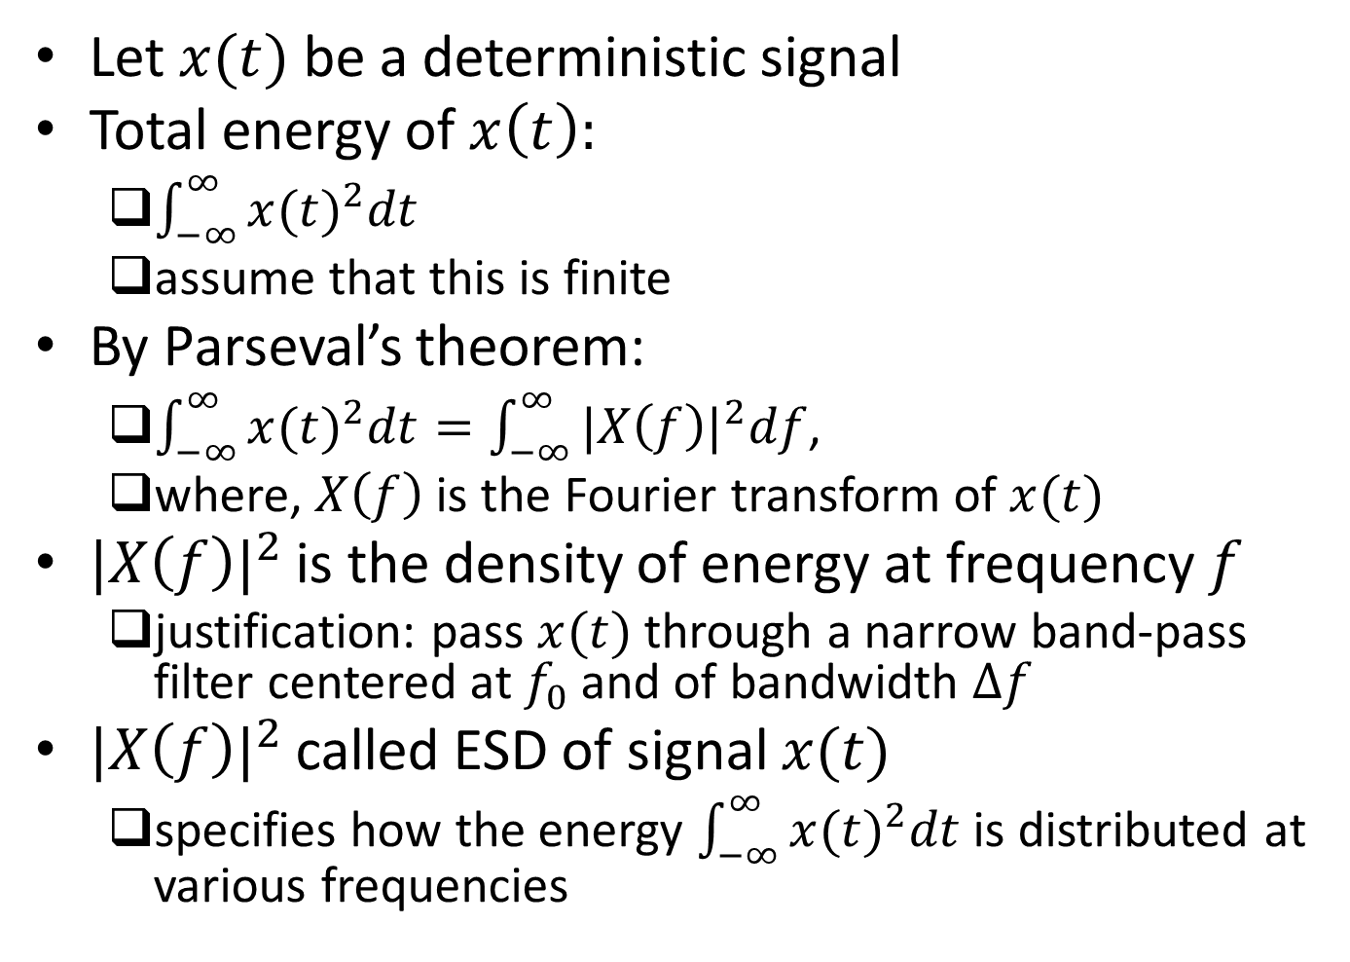
Energy Spectral Density
Let $x(t)$ be a deterministic signal
Total energy of $x\left(t\right):$
$\int_{−∞}^{∞}{{x(t)}^{2}dt}$
assume that this is finite
By Parseval’s theorem:
$\int_{−∞}^{∞}{{x(t)}^{2}dt}=\int_{−∞}^{∞}{{|X\left(f\right)|}^{2}df}$,
where, $X\left(f\right)$ is the Fourier transform of $x(t)$
${|X\left(f\right)|}^{2}$ is the density of energy at frequency $f$
justification: pass $x(t)$ through a narrow band-pass filter centered at $f_{0}$ and of bandwidth $∆f$
${|X\left(f\right)|}^{2}$ called ESD of signal $x(t)$
specifies how the energy $\int_{−∞}^{∞}{{x(t)}^{2}dt}$ is distributed at various frequencies

Slide 25
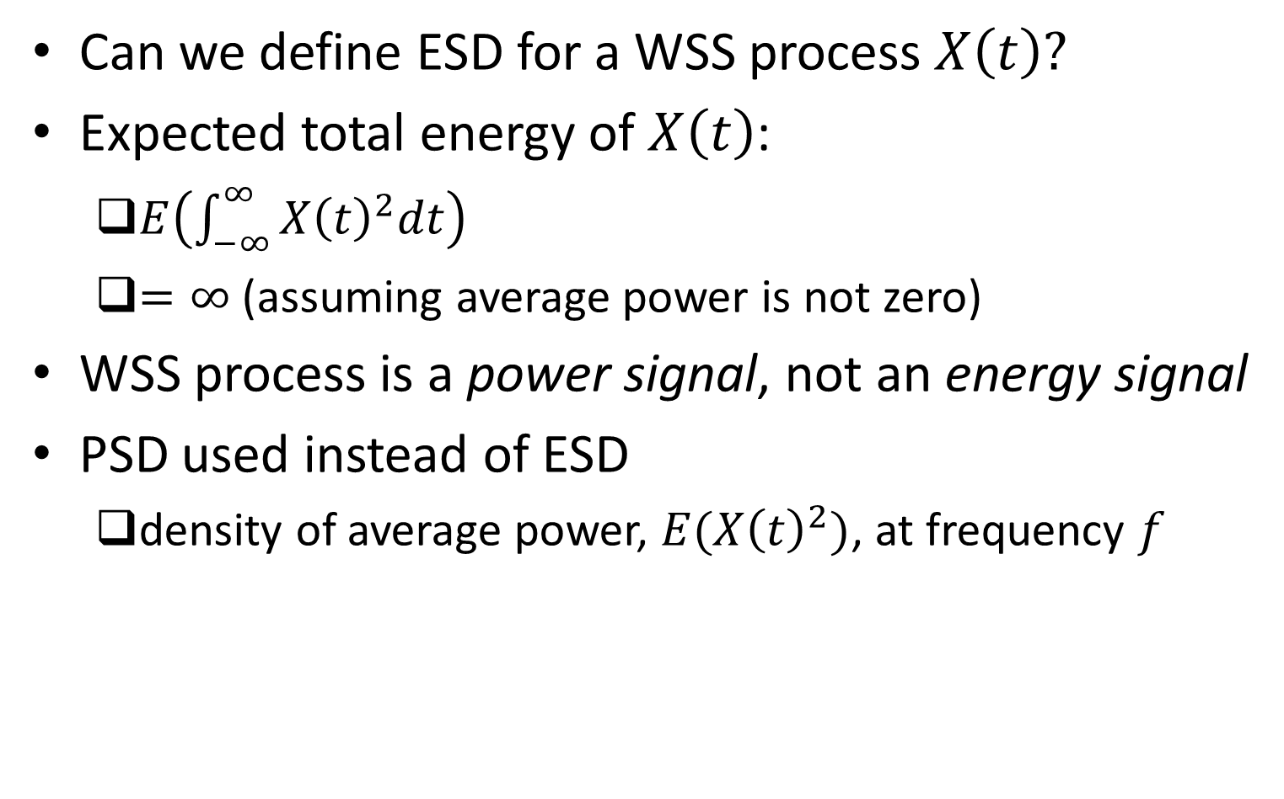
Power Spectral Density: Motivation
Can we define ESD for a WSS process $X\left(t\right)?$
Expected total energy of $X\left(t\right)$:
$E\left(\int_{−∞}^{∞}{{X\left(t\right)}^{2}dt}\right)$
$=∞$ (assuming average power is not zero)
WSS process is a power signal, not an energy signal
PSD used instead of ESD
density of average power, $E({X\left(t\right)}^{2})$, at frequency $f$

Slide 26
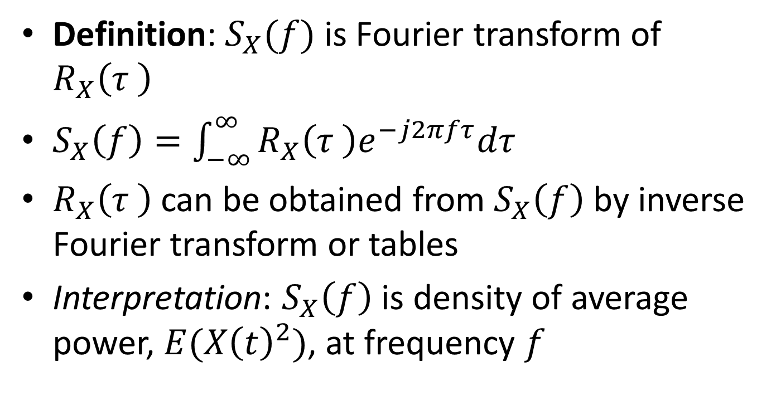
Power Spectral Density
Definition: $S_{X}(f)$ is Fourier transform of $R_{X}\left(τ \right)$
$S_{X}\left(f\right)=\int_{−∞}^{∞}{R_{X}\left(τ \right)e^{−j2πfτ}dτ}$
$R_{X}\left(τ \right)$ can be obtained from $S_{X}\left(f\right)$ by inverse Fourier transform or tables
Interpretation: $S_{X}\left(f\right)$ is density of average power, $E({X\left(t\right)}^{2})$, at frequency $f$

Slide 27

Example
In above example:
$$R_{X}\left(τ \right)=\left\{\begin{matrix}A^{2}\left(1−\frac{|τ|}{T}\right), & \left|τ\right|<T, \\ 0, & \text{else}.\end{matrix}\right.$$
$S_{X}\left(f\right):$
$A^{2}T{\text{sinc}}^{2}\left(fT\right)$

Slide 28
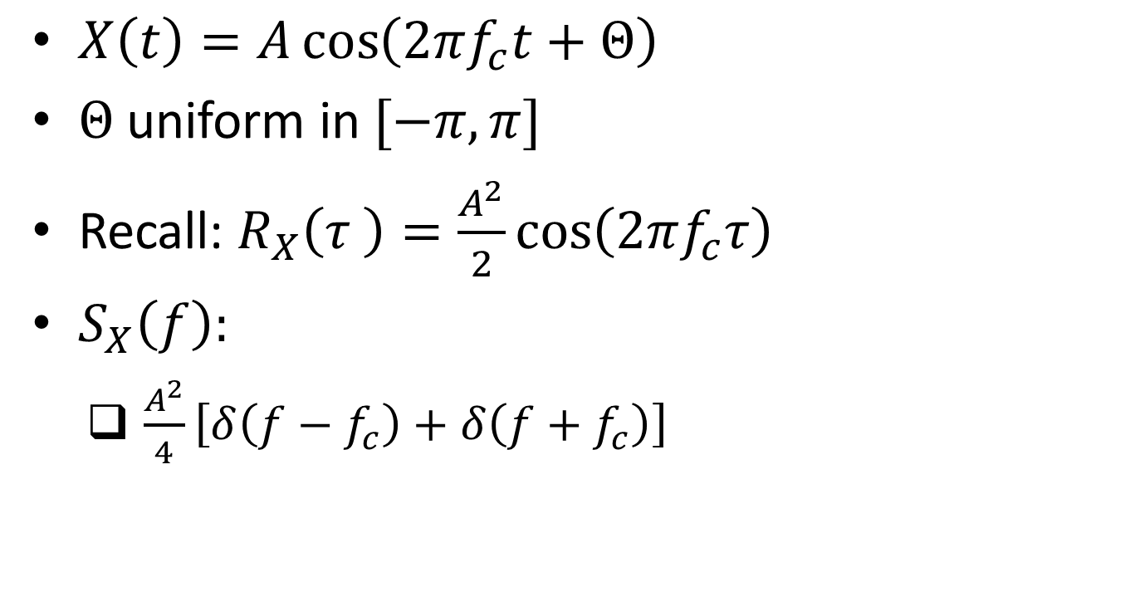
Example
$X\left(t\right)=A\cos\left(2πf_{c}t+Θ\right)$
$Θ$ uniform in $[−π,π]$
Recall: $R_{X}\left(τ \right)=\frac{A^{2}}{2}\cos\left(2πf_{c}τ\right)$
$S_{X}\left(f\right):$
$\frac{A^{2}}{4}\left[δ\left(f−f_{c}\right)+δ\left(f+f_{c}\right)\right]$

Slide 29


Properties of $S_{X}\left(f\right)$
$S_{X}\left(f\right)$ is real and even
$E\left({X\left(t\right)}^{2}\right)=\int_{−∞}^{∞}{S_{X}\left(f\right)df}$
consistent with interpretation that $S_{X}\left(f\right)$ is density of average power, $E({X\left(t\right)}^{2})$, at frequency $f$

Slide 30
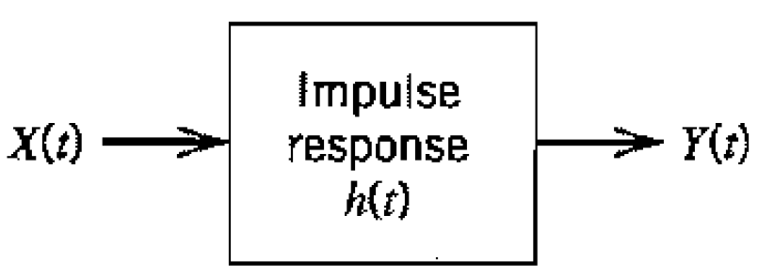
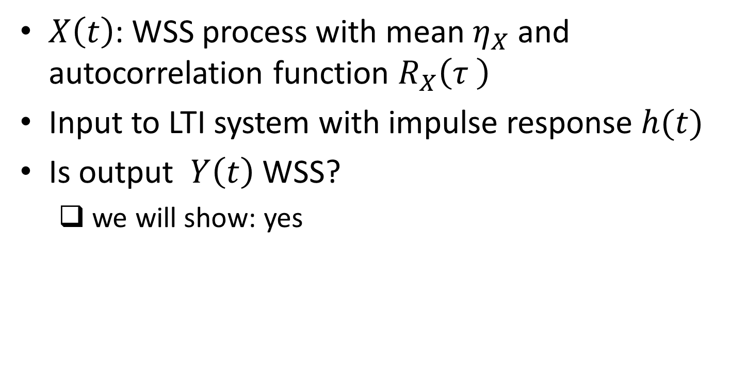
WSS Process Through LTI Filter
$X\left(t\right)$: WSS process with mean $η_{X}$ and autocorrelation function $R_{X}\left(τ \right)$
Input to LTI system with impulse response $h(t)$
Is output $Y\left(t\right)$ WSS?
we will show: yes
Ref: Haykin, Chapter 1

Slide 31
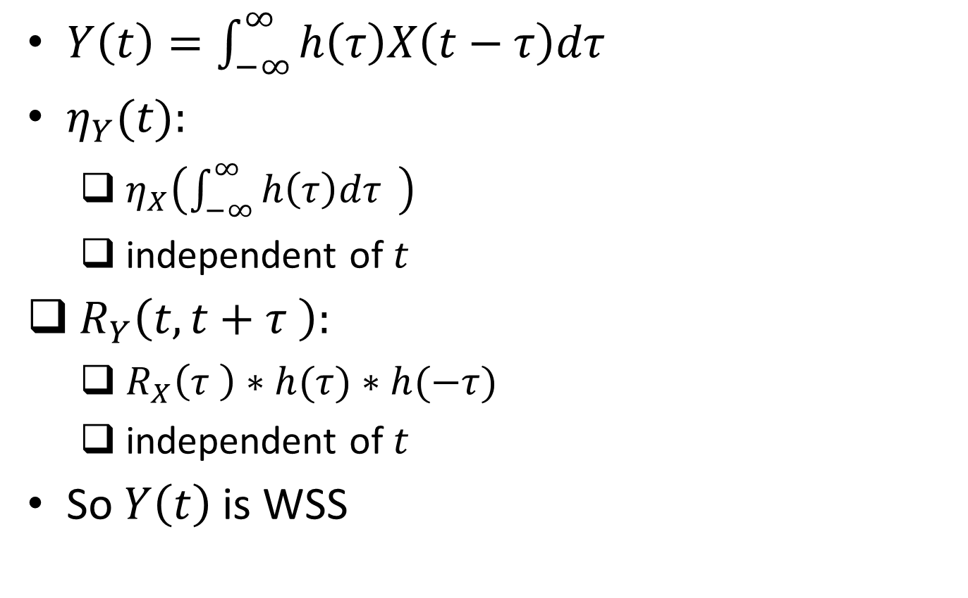

$η_{Y}(t)$ and $R_{Y}\left(t,t+τ \right)$
$Y\left(t\right)=\int_{−∞}^{∞}{h\left(τ\right)X\left(t−τ\right)dτ}$
$η_{Y}(t):$
$η_{X}\left(\int_{−∞}^{∞}{h\left(τ\right)dτ} \right)$
independent of $t$
$R_{Y}\left(t,t+τ \right):$
$R_{X}\left(τ \right)∗h(τ)∗h(−τ)$
independent of $t$
So $Y\left(t\right)$ is WSS

Slide 32


PSD of $Y\left(t\right)$
$R_{Y}\left(τ \right)=R_{X}\left(τ \right)∗h(τ)∗h(−τ)$
Let $H\left(f\right)$ be Fourier transform of $h(t)$
$S_{Y}\left(f\right):$
$S_{X}\left(f\right){|H\left(f\right)|}^{2}$

Slide 33
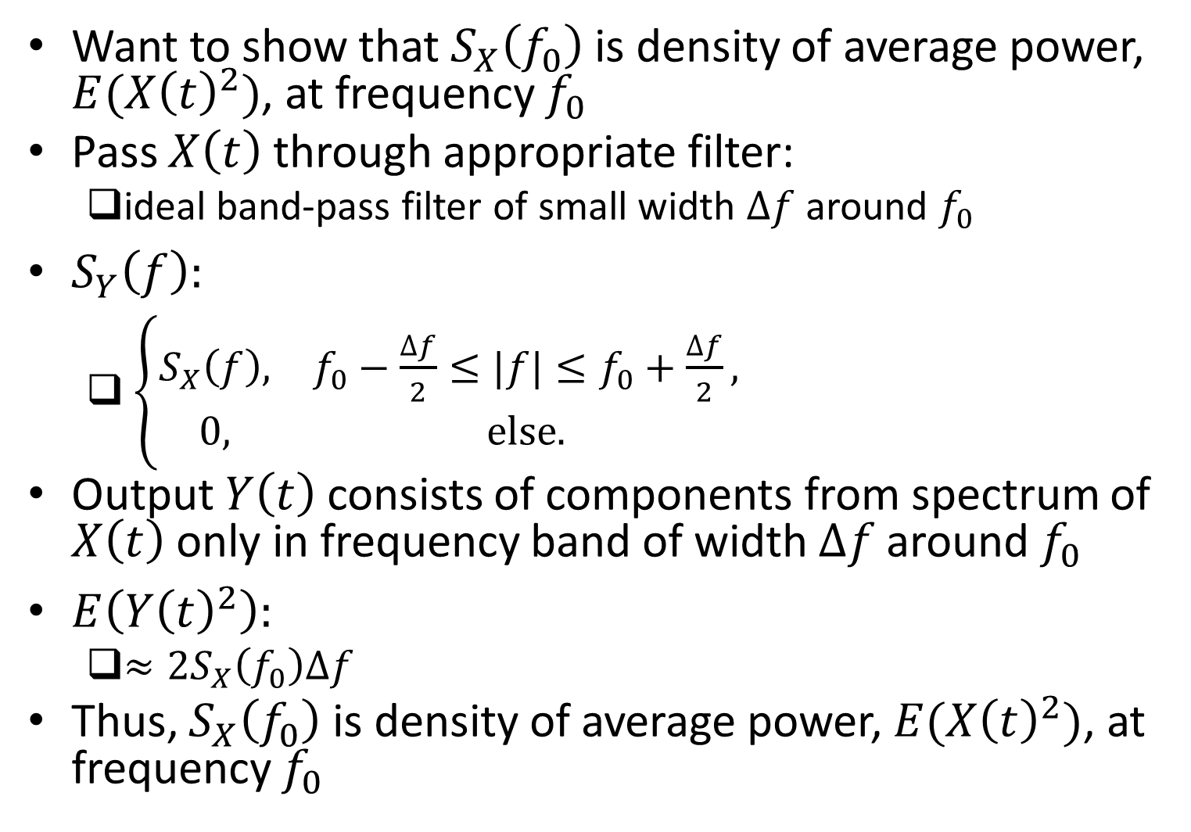
Interpretation of PSD
Want to show that $S_{X}\left(f_{0}\right)$ is density of average power, $E({X\left(t\right)}^{2})$, at frequency $f_{0}$
Pass $X\left(t\right)$ through appropriate filter:
ideal band-pass filter of small width $∆f$ around $f_{0}$
$S_{Y}\left(f\right):$
$\left\{\begin{matrix}S_{X}\left(f\right), & f_{0}−\frac{∆f}{2}≤|f|≤f_{0}+\frac{∆f}{2}, \\ 0, & \text{else}.\end{matrix}\right.$
Output $Y\left(t\right)$ consists of components from spectrum of $X\left(t\right)$ only in frequency band of width $∆f$ around $f_{0}$
$E\left({Y\left(t\right)}^{2}\right):$
$≈2S_{X}\left(f_{0}\right)∆f$
Thus, $S_{X}\left(f_{0}\right)$ is density of average power, $E({X\left(t\right)}^{2})$, at frequency $f_{0}$

Slide 34

Non-Negativity of PSD
$S_{X}\left(f_{0}\right)≥0$ for all $f_{0}$
Proof:
$Y\left(t\right)$ as in previous slide
$E\left({Y\left(t\right)}^{2}\right)≈2S_{X}\left(f_{0}\right)∆f≥0$

Slide 35
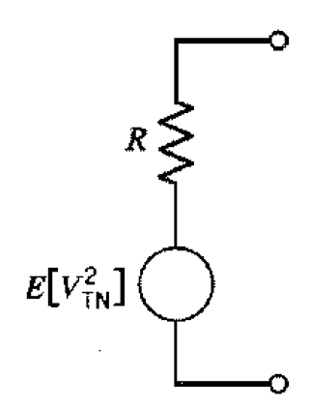
Gaussian Processes: Motivation
Thermal noise in resistor often modeled as Gaussian process
noise that arises due to random motion of electrons in resistor

Slide 36
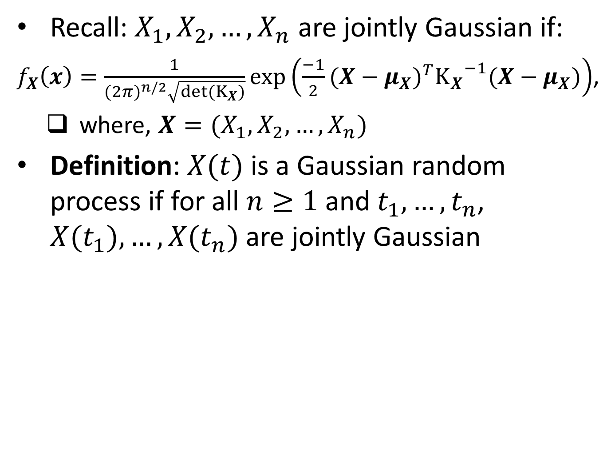
Gaussian Process: Definition
Recall: $X_{1},X_{2},…,X_{n}$ are jointly Gaussian if:
$f_{X}\left(x\right)=\frac{1}{{(2π)}^{n/2}\sqrt{{det(K}_{X})}}\text{exp}\left(\frac{−1}{2}{(X−μ_{X})}^{T}{K_{X}}^{−1}(X−μ_{X})\right)$,
where, $X=(X_{1},X_{2},…,X_{n})$
Definition: $X(t)$ is a Gaussian random process if for all $n≥1$ and $t_{1},…,t_{n}$, ${X(t}_{1}),…,{X(t}_{n})$ are jointly Gaussian

Slide 37
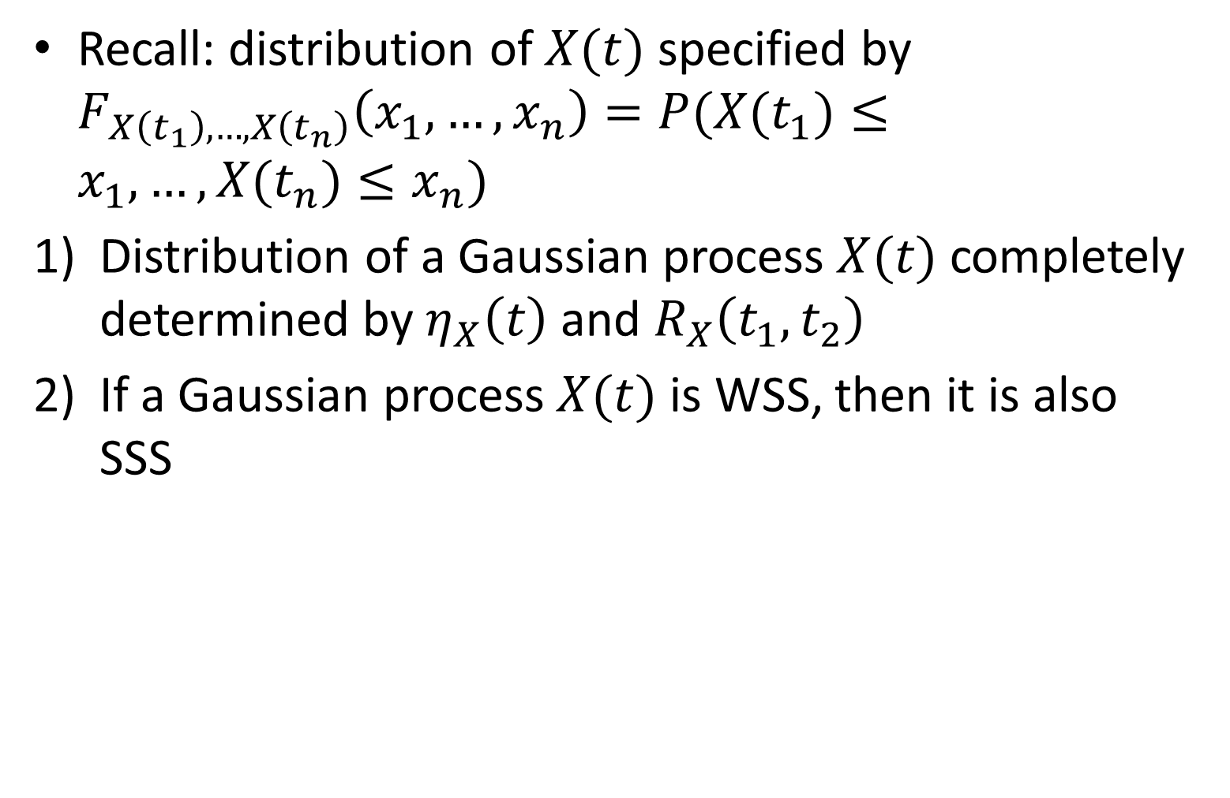
Properties
Recall: distribution of $X(t)$ specified by $F_{X\left(t_{1}\right),…,X\left(t_{n}\right)}\left(x_{1},…,x_{n}\right)=P(X(t_{1})≤x_{1},…,X(t_{n})≤x_{n})$
Distribution of a Gaussian process $X(t)$ completely determined by $η_{X}\left(t\right)$ and $R_{X}\left(t_{1},t_{2}\right)$
If a Gaussian process $X(t)$ is WSS, then it is also SSS

Slide 38
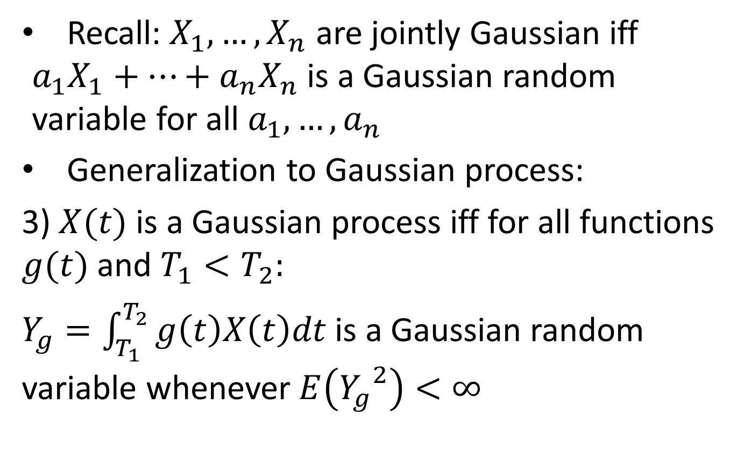
Properties (contd.)
Recall: $X_{1}, …,X_{n}$ are jointly Gaussian iff $a_{1}X_{1}+…+a_{n}X_{n}$ is a Gaussian random variable for all $a_{1},…,a_{n}$
Generalization to Gaussian process:
3) $X(t)$ is a Gaussian process iff for all functions $g(t)$ and $T_{1}<T_{2}:$
$Y_{g}=\int_{T_{1}}^{T_{2}}{g\left(t\right)X\left(t\right)dt}$ is a Gaussian random variable whenever $E\left({Y_{g}}^{2}\right)<∞$

Slide 39
Applications of Gaussian Processes
Many physical processes are approximately Gaussian
Reasons:
A large-scale phenomenon often arises from the combination of a large number of small-scale i.i.d. phenomena
Central Limit Theorem

Slide 40
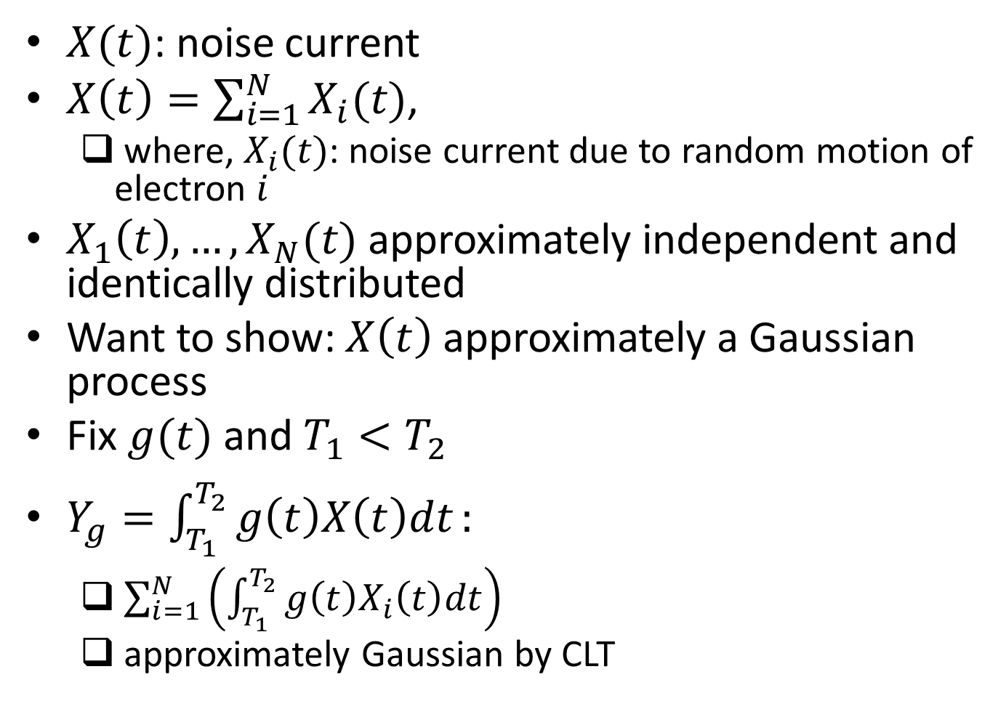
Thermal Noise
$X(t)$: noise current
$X\left(t\right)=\sum_{i=1}^{N}{X_{i}(t)}$,
where, $X_{i}(t)$: noise current due to random motion of electron $i$
$X_{1}\left(t\right),…,X_{N}(t)$ approximately independent and identically distributed
Want to show: $X\left(t\right)$ approximately a Gaussian process
Fix $g(t)$ and $T_{1}<T_{2}$
$Y_{g}=\int_{T_{1}}^{T_{2}}{g\left(t\right)X\left(t\right)dt}:$
$\sum_{i=1}^{N}{\left(\int_{T_{1}}^{T_{2}}{g\left(t\right)X_{i}\left(t\right)dt}\right)}$
approximately Gaussian by CLT

Slide 41

Gaussian Process Through LTI System
If a Gaussian process, $X(t)$, is input to LTI system, then output $Y(t)$ is a Gaussian process

Slide 42
White Noise Process: Motivation
Recall: thermal noise in resistor
noise that arises due to random motion of electrons
Modeled as a white noise process

Slide 43
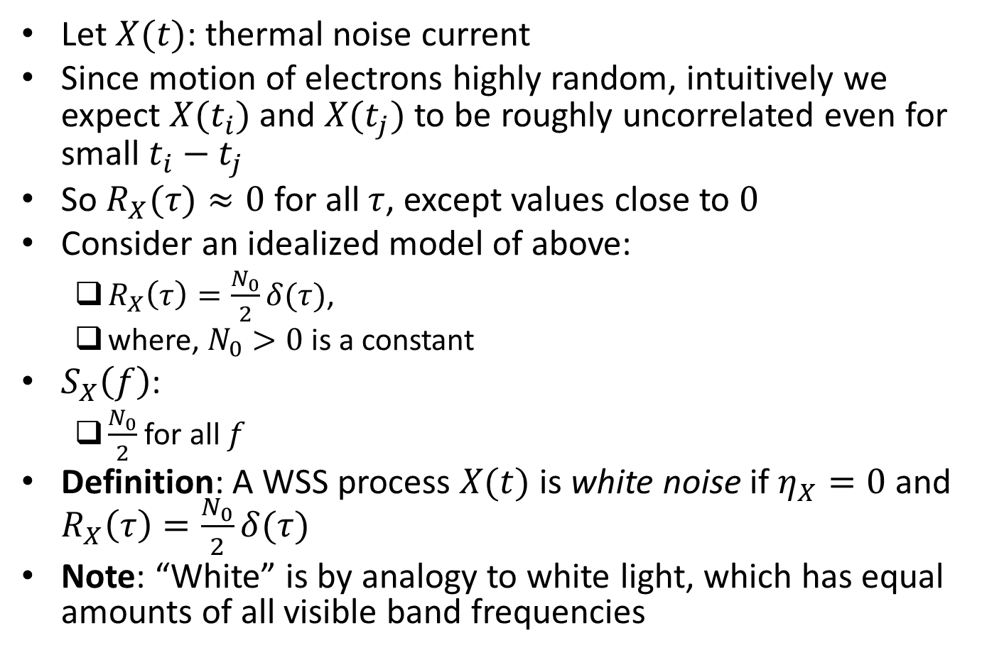
White Noise Process
Let $X(t)$: thermal noise current
Since motion of electrons highly random, intuitively we expect $X(t_{i})$ and $X(t_{j})$ to be roughly uncorrelated even for small $t_{i}−t_{j}$
So $R_{X}(τ)≈0$ for all $τ$, except values close to $0$
Consider an idealized model of above:
$R_{X}\left(τ\right)=\frac{N_{0}}{2}δ(τ)$,
where, $N_{0}>0$ is a constant
$S_{X}\left(f\right)$:
$\frac{N_{0}}{2}$ for all $f$
Definition: A WSS process $X(t)$ is white noise if $η_{X}=0$ and $R_{X}\left(τ\right)=\frac{N_{0}}{2}δ(τ)$
Note: “White” is by analogy to white light, which has equal amounts of all visible band frequencies

Slide 44
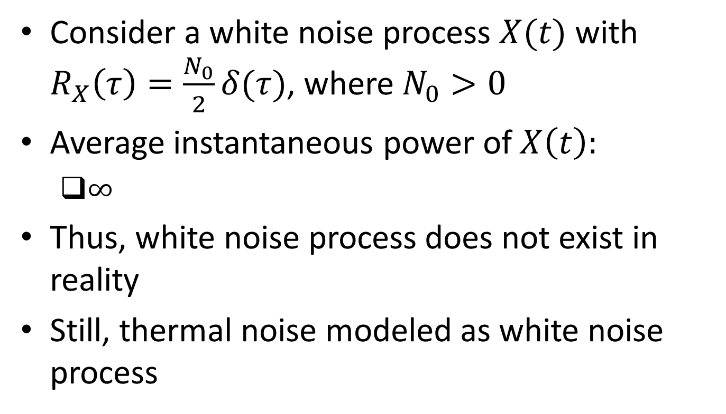
Average Instantaneous Power
Consider a white noise process $X(t)$ with $R_{X}\left(τ\right)=\frac{N_{0}}{2}δ(τ)$, where $N_{0}>0$
Average instantaneous power of $X\left(t\right):$
$∞$
Thus, white noise process does not exist in reality
Still, thermal noise modeled as white noise process

Slide 45
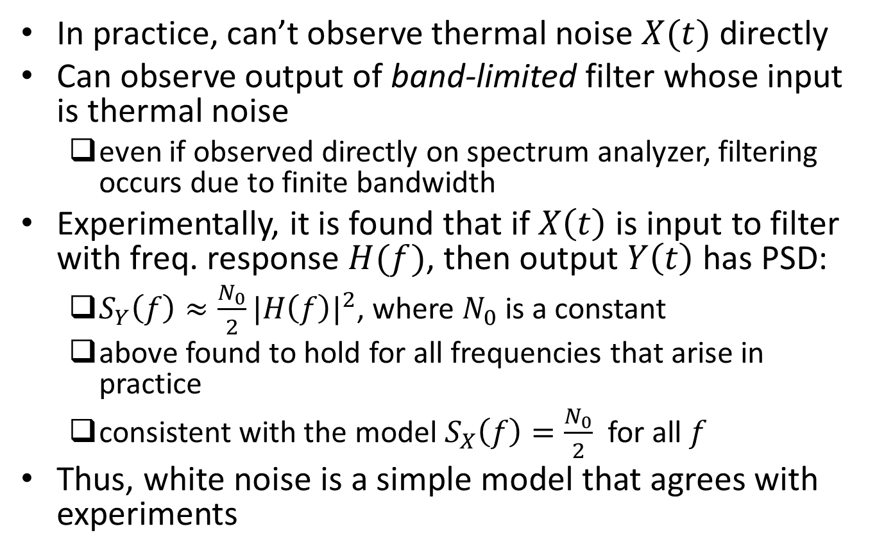
Reason for Modeling Thermal Noise as White Noise Process
In practice, can’t observe thermal noise $X(t)$ directly
Can observe output of band-limited filter whose input is thermal noise
even if observed directly on spectrum analyzer, filtering occurs due to finite bandwidth
Experimentally, it is found that if $X\left(t\right)$ is input to filter with freq. response $H(f)$, then output $Y\left(t\right)$ has PSD:
$S_{Y}\left(f\right)≈\frac{N_{0}}{2}{|H\left(f\right)|}^{2}$, where $N_{0}$ is a constant
above found to hold for all frequencies that arise in practice
consistent with the model $S_{X}\left(f\right)=\frac{N_{0}}{2}$ for all $f$
Thus, white noise is a simple model that agrees with experiments

Slide 46
Additive White Gaussian Noise
Recall: thermal noise modeled as a Gaussian process as well as white noise
“white Gaussian noise”
More generally, noise in communication systems widely modeled as AWGN
“additive” since assumed to add to transmitted signal
Generated by a number of sources:
e.g., thermal noise, shot noise, black body radiation

Slide 47
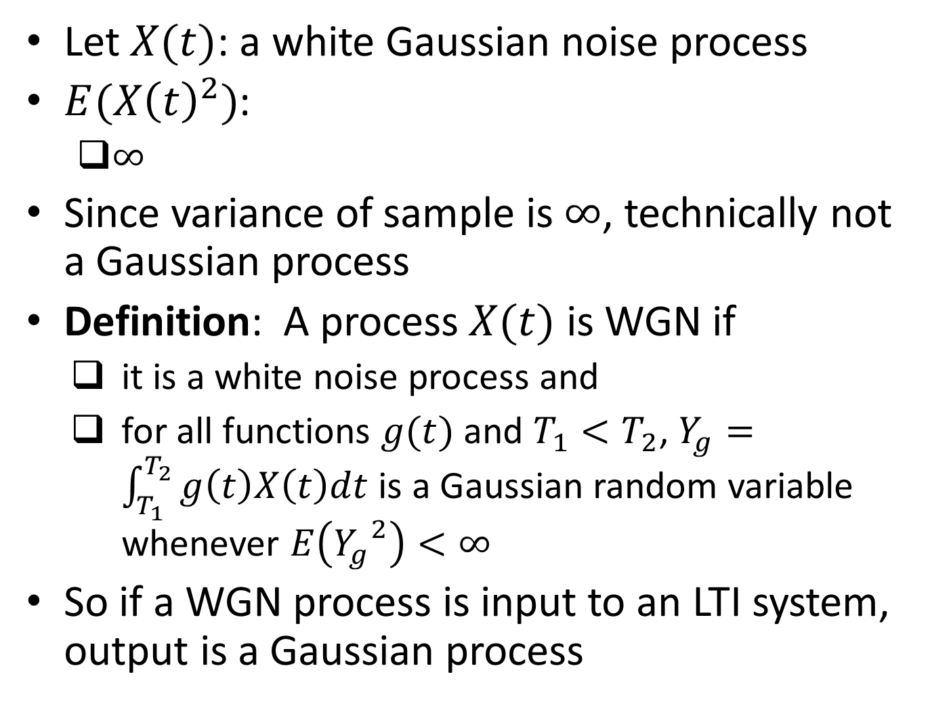
Technical Note
Let $X(t)$: a white Gaussian noise process
$E({X\left(t\right)}^{2})$:
$∞$
Since variance of sample is $∞$, technically not a Gaussian process
Definition: A process $X(t)$ is WGN if
it is a white noise process and
for all functions $g(t)$ and $T_{1}<T_{2}$, $Y_{g}=\int_{T_{1}}^{T_{2}}{g\left(t\right)X\left(t\right)dt}$ is a Gaussian random variable whenever $E\left({Y_{g}}^{2}\right)<∞$
So if a WGN process is input to an LTI system, output is a Gaussian process

Slide 48
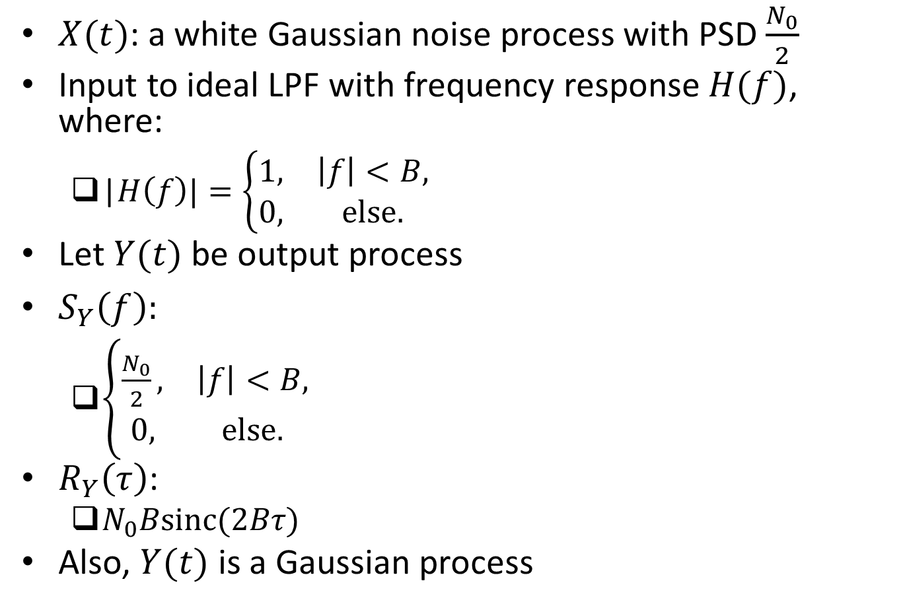
Example: Low-Pass Filtered WGN
$X(t)$: a white Gaussian noise process with PSD $\frac{N_{0}}{2}$
Input to ideal LPF with frequency response $H(f)$, where:
|$H\left(f\right)|=\left\{\begin{matrix}1, & \left|f\right|<B, \\ 0, & else.\end{matrix}\right.$
Let $Y(t)$be output process
$S_{Y}\left(f\right):$
$\left\{\begin{matrix}\frac{N_{0}}{2}, & \left|f\right|<B, \\ 0, & else.\end{matrix}\right.$
$R_{Y}\left(τ\right)$:
$N_{0}Bsinc(2Bτ)$
Also, $Y(t)$ is a Gaussian process

Slide 49
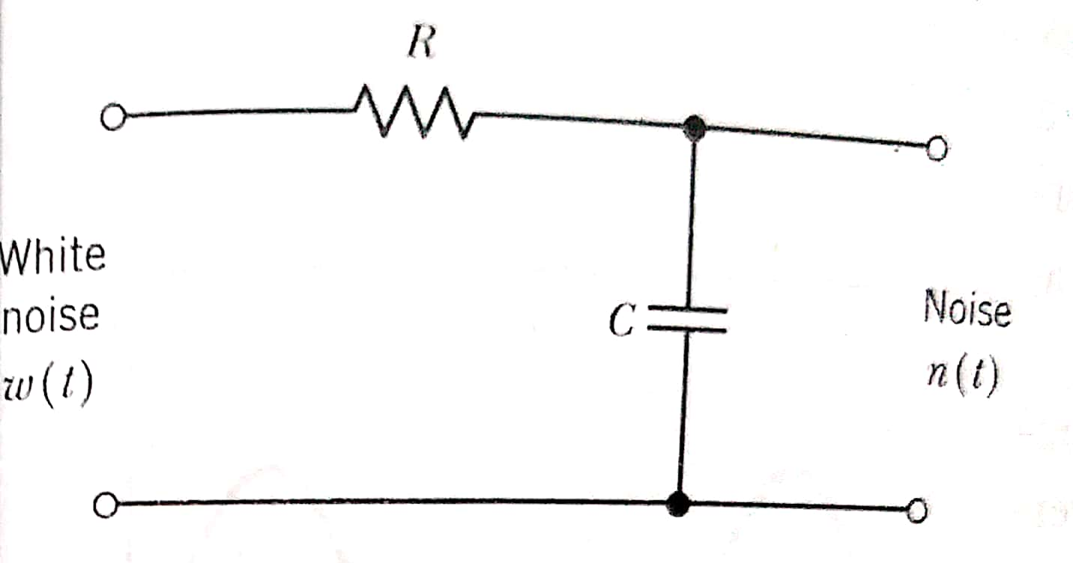

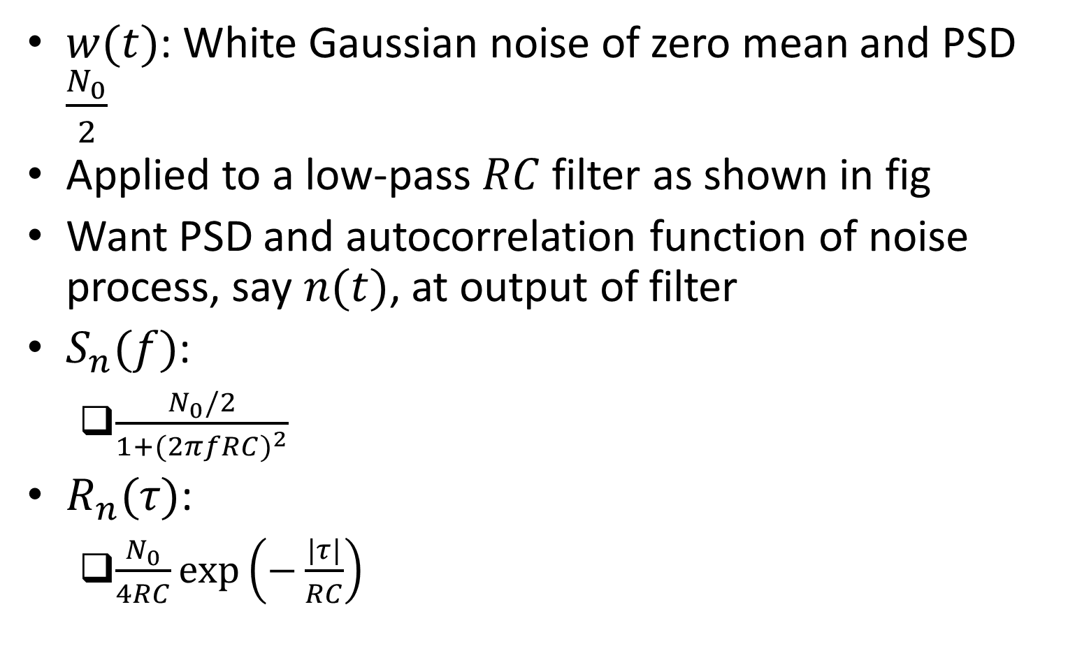
Example: $RC$ Low-Pass Filtered White Noise
$w(t)$: White Gaussian noise of zero mean and PSD $\frac{N_{0}}{2}$
Applied to a low-pass $RC$ filter as shown in fig
Want PSD and autocorrelation function of noise process, say $n(t)$, at output of filter
$S_{n}(f)$:
$\frac{N_{0}/2}{1+{(2πfRC)}^{2}}$
$R_{n}(τ)$:
$\frac{N_{0}}{4RC}exp\left(−\frac{|τ|}{RC}\right)$
Ref: “Communication Systems” by Haykin and Moher

Slide 50

Cross-Correlation Function
Consider two random processes $X(t)$ and $Y(t)$ with autocorrelation functions $R_{X}(t,u)$ and $R_{Y}(t,u)$ respectively
Cross-correlation function of $X(t)$ and $Y(t)$ defined to be:
$R_{XY}\left(t,u\right)=E\left[X\left(t\right)Y(u)\right]$
$X(t)$ and $Y(t)$ said to be jointly wide-sense stationary if:
they are both WSS and
$R_{XY}\left(t,u\right)$ depends only on the difference $τ=t−u$

Slide 51

Example: Quadrature Modulated Processes
Suppose $X(t)$ is a WSS process and let:
$X_{1}\left(t\right)=X\left(t\right)cos⁡(2πf_{c}t+Θ)$,
$X_{2}\left(t\right)=X\left(t\right)sin⁡(2πf_{c}t+Θ)$,
where $Θ$ is uniformly distributed over $(0,2π)$ and is independent of $X(t)$
Are $X_{1}\left(t\right)$ and $X_{2}\left(t\right)$ jointly WSS?
Are $X_{1}\left(t\right)$ and $X_{2}\left(t\right)$ WSS?
Yes
$R_{X_{1}X_{2}}(t,u)$:
$−\frac{1}{2}R_{X}\left(τ\right)sin⁡(2πf_{c}τ)$,
where $τ=t−u$
So $X_{1}\left(t\right)$ and $X_{2}\left(t\right)$ are jointly WSS

